Slide 1
Word2Vec
Hung-Hsuan Chen

Slide 2
Attribute of a text document
One-hot encoding the words

Slide 3
Term-document count matrices
Consider the number of occurrences of a term in a document:
Each document is a count vector in ℕ^{v}: a column below

Slide 4
Bag of words model
Vector representation doesn’t consider the ordering of words in a document
John is quicker than Mary and Mary is quicker than John have the same vectors
This is called the bag of words model.

Slide 5
Term frequency tf
The term frequency tf_{t,d} of term t in document d is defined as the number of times that t occurs in d.
We want to use tf when computing query-document match scores. But how?
Raw term frequency is not what we want:
A document with 10 occurrences of the term is more relevant than a document with 1 occurrence of the term.
But not 10 times more relevant.
Relevance does not increase proportionally with term frequency.

Slide 6
Log-frequency weighting
The log frequency weight of term t in d is
0 → 0, 1 → 1, 2 → 1.3, 10 → 2, 1000 → 4, etc.
Score for a document-query pair: sum over terms t in both q and d:
score
The score is 0 if none of the query terms is present in the document.

Slide 7
Document frequency
Rare terms are more informative than frequent terms
Recall stop words
Consider a term in the query that is rare in the collection (e.g., arachnocentric)
A document containing this term is very likely to be relevant to the query arachnocentric
We want a high weight for rare terms like arachnocentric.
We will use document frequency (df) to capture this

Slide 8
idf weight
df_{t} is the document frequency of t: the number of documents that contain t
df_{t} is an inverse measure of the informativeness of t
df_{t} ≤ N
We define the idf (inverse document frequency) of t by
We use log (N/df_{t}) instead of N/df_{t} to “dampen” the effect of idf.

Slide 9
idf example, suppose N = 1 million
term | df_{t} | idf_{t}
calpurnia | 1
animal | 100
sunday | 1,000
fly | 10,000
under | 100,000
the | 1,000,000
There is one idf value for each term t in a collection.

Slide 10
tf-idf weighting
The tf-idf weight of a term is the product of its tf weight and its idf weight.
Best known weighting scheme in information retrieval
Note: the “-” in tf-idf is a hyphen, not a minus sign!
Alternative names: tf.idf, tf x idf
Increases with the number of occurrences within a document
Increases with the rarity of the term in the collection
Many variants, e.g., BM25

Slide 11
These are all bag-of-words model
The feature sets are the same
Each word is a feature
The feature values are generated in different ways
Based on term counts
Based on log of term frequency
Based on tf-idf
Compare document similarity by vectors
Compare word similarity by vectors

Slide 12
N-grams

Slide 13
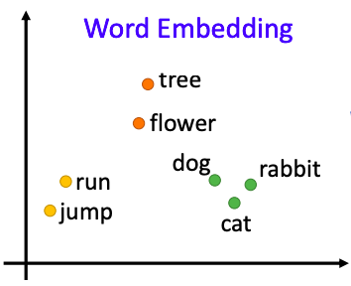
Word2Vec
Learning the word vectors from a large collection of documents
Resulting word representation
Similar words are closer
The word vectors capture the semantic of the words
The output vectors are also known as word embedding

Slide 14
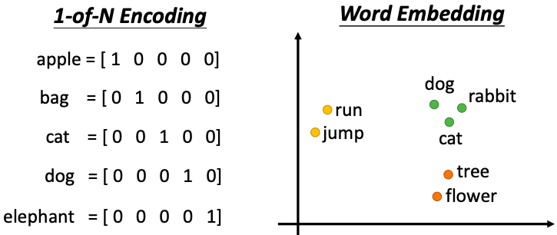
One-hot encoding vs word embedding

Slide 16
Word2Vec (training data: Chinese Wikipedia)
台灣 : 台北 = 法國 : ?
⇒ 巴黎 (0.9350)
國民黨 : 馬英九 = 民進黨 : ?
⇒ 陳水扁 (0.9844)
海賊王 : 魯夫 = 火影忍者 : ?
⇒ 自來也 (0.7876)
爵士樂 : 紐奧良 = 鄉村音樂 : ?
⇒ 納許維爾 (0.9718)
中研院 : 李遠哲 = 工研院 : ?
⇒ 林同炎 (0.9381)
台灣 : 台灣大學 = 美國 : ?
⇒ 約翰霍普金斯大學 (0.9976)

Slide 17
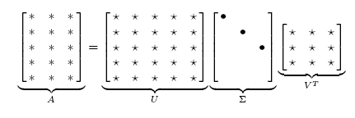
Singular Value Decomposition
U and V are unitary matrices
I.e., $U^{T}U=I; V^{T}V=I$
$Σ$ is a diagonal matrix
The diagonal entries $σ_{i}$ of $Σ$ are known as the singular values of A, commonly listed in descending order

Slide 18
Reduced SVD
If we retain only k largest singular values, and set the rest to 0
Then Σ is k×k, U is M×k, V^{T} is k×N, and A_{k} is M×N
This is referred to as the reduced SVD
It is the convenient (space-saving) and usual form for computational applications
Among matrices with rank k, A_{k} he best approximation of A (in terms of Frobenius norm)

Slide 20
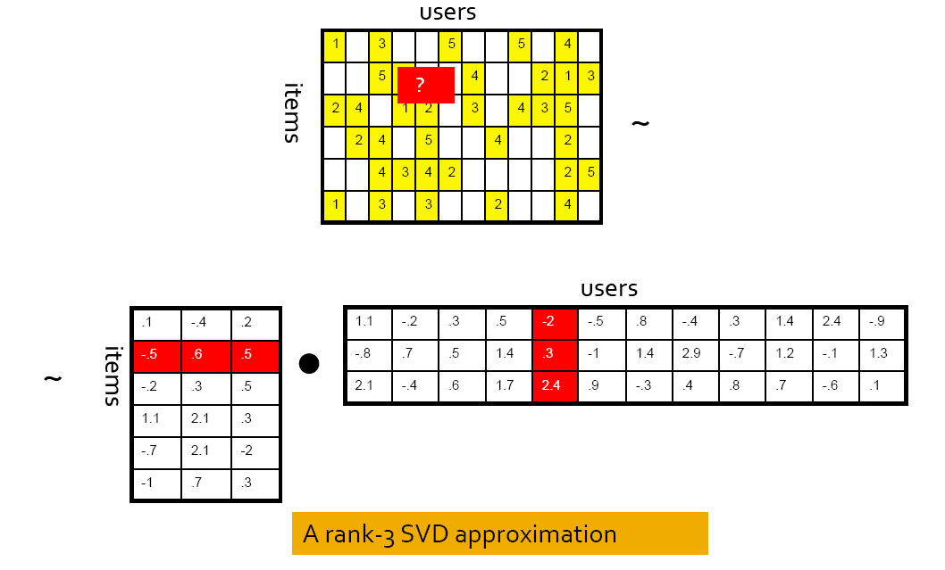
Relationship with matrix factorization (in recommender systems)

Slide 21
Counting-based vs prediction-based model
Counting-based
Generate the word representation based on the co-occurrence counts
Perform matrix factorization
Prediction-based
Predict the words based on the neighboring words
The word representation is a by-product of the prediction task

Slide 22
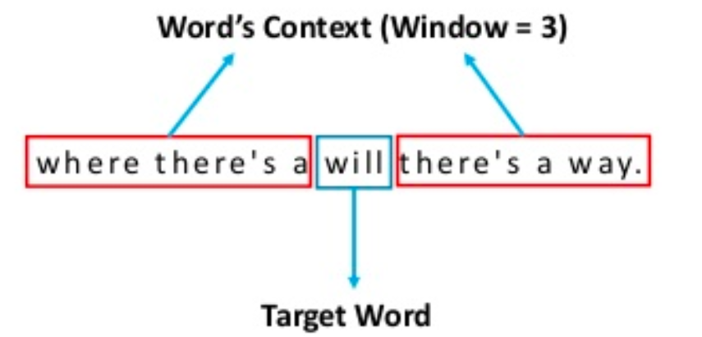
Two popular types of prediction-based model
Continuous bag-of-words (CBOW)
Predict current word based on the context
Skip-gram
Predict the context words based on the current word
A word’s context

Slide 23
CBOW vs Skip-gram

Slide 24
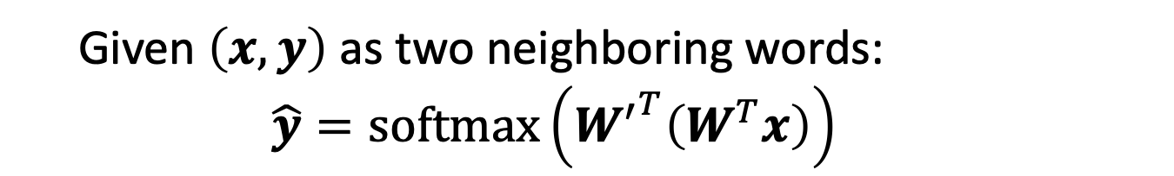
Simple CBOW
Given $\left(x,y\right)$ as two neighboring words:
$$\hat{y}=softmax\left({W^{′}}^{T}\left(W^{T}x\right)\right)$$

Slide 25
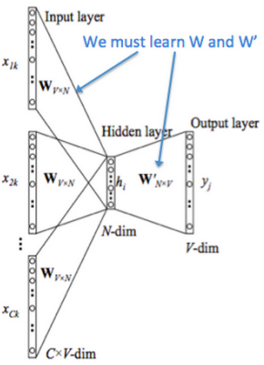
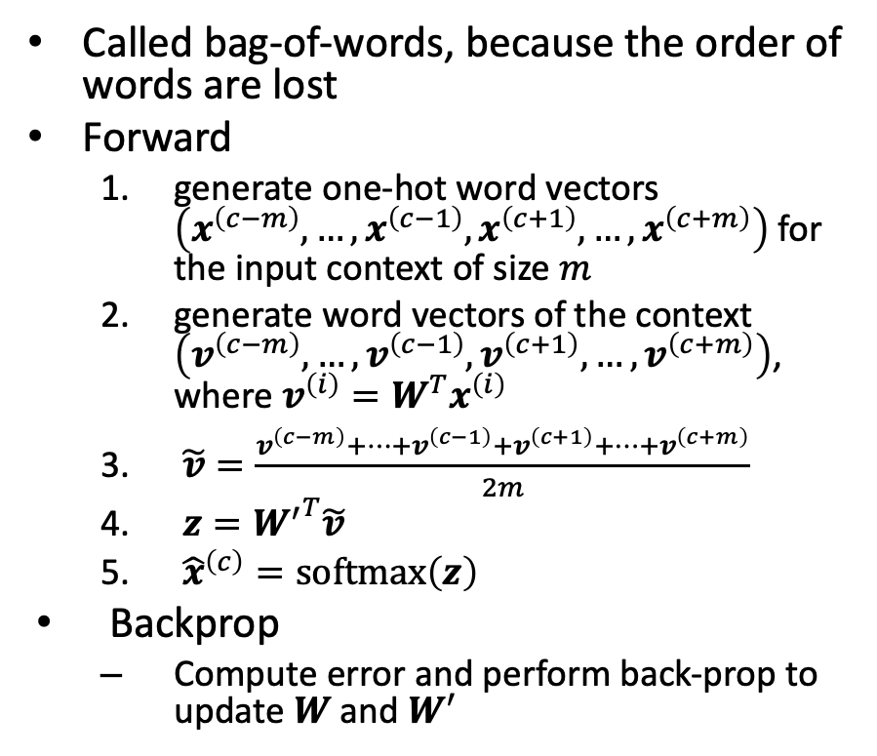
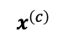
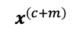
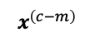
Continuous bag-of-words (CBOW)
Called bag-of-words, because the order of words are lost
Forward
generate one-hot word vectors $\left(x^{\left(c−m\right)},…,x^{\left(c−1\right)},x^{\left(c+1\right)},…,x^{\left(c+m\right)}\right)$ for the input context of size $m$
generate word vectors of the context $\left(v^{\left(c−m\right)},…,v^{\left(c−1\right)},v^{\left(c+1\right)},…,v^{\left(c+m\right)}\right)$, where $v^{\left(i\right)}=W^{T}x^{\left(i\right)}$
$\tilde{v}=\frac{v^{\left(c−m\right)}+…+v^{\left(c−1\right)}+v^{\left(c+1\right)}+…+v^{\left(c+m\right)}}{2m}$
$z={W^{′}}^{T}\tilde{v}$
${\hat{x}}^{\left(c\right)}=softmax\left(z\right)$
Backprop
Compute error and perform back-prop to update $W$ and $W^{′}$
$$x^{\left(c−m\right) }$$
$$x^{\left(c\right) }$$
$$x^{\left(c+m\right) }$$

Slide 26
Input layer
Index of cat in vocabulary
0
1
0
cat
0
Hidden layer
Output layer
0
0
0
0
0
0
…
0
0
0
one-hot
vector
0
sat
one-hot
vector
0
0
0
0
1
0
…
1
0
on
0
0
0
0
…
0

Slide 27
We must learn W and W’
Input layer
0
1
0
cat
0
$$W_{V×N}$$
Hidden layer
Output layer
0
0
0
0
0
0
V-dim
…
0
0
$${W′}_{N×V}$$
0
0
sat
0
0
0
0
1
0
$$W_{V×N}$$
N-dim
…
V-dim
1
0
on
0
0
0
0
V-dim
…
N will be the size of word vector
0

Slide 28
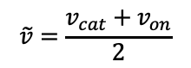
$$W_{V×N}^{T} ×x_{cat}=v_{cat}$$
0.1 | 2.4 | 1.6 | 1.8 | 0.5 | 0.9 | … | … | … | 3.2
0.5 | 2.6 | 1.4 | 2.9 | 1.5 | 3.6 | … | … | … | 6.1
… | … | … | … | … | … | … | … | … | …
… | … | … | … | … | … | … | … | … | …
0.6 | 1.8 | 2.7 | 1.9 | 2.4 | 2.0 | … | … | … | 1.2
0
2.4
2.6
…
…
1.8
Input layer
1
$$×$$
0
$$=$$
0
0
1
0
0
0
x_{cat}
0
0
Output layer
0
0
0
$$W_{V×N}^{T}×x_{cat}=v_{cat}$$
…
0
0
0
0
0
V-dim
…
0
0
$$\tilde{v}=\frac{v_{cat}+v_{on}}{2}$$
0
+
0
sat
0
0
0
0
$$W_{V×N}^{T}×x_{on}=v_{on}$$
1
0
…
V-dim
1
Hidden layer
0
x_{on}
0
0
N-dim
0
0
V-dim
…
0

Slide 29
$$W_{V×N}^{T} ×x_{on}=v_{on}$$
0.1 | 2.4 | 1.6 | 1.8 | 0.5 | 0.9 | … | … | … | 3.2
0.5 | 2.6 | 1.4 | 2.9 | 1.5 | 3.6 | … | … | … | 6.1
… | … | … | … | … | … | … | … | … | …
… | … | … | … | … | … | … | … | … | …
0.6 | 1.8 | 2.7 | 1.9 | 2.4 | 2.0 | … | … | … | 1.2
0
1.8
2.9
…
…
1.9
Input layer
0
$$×$$
0
$$=$$
0
1
1
0
0
0
x_{cat}
0
0
Output layer
0
0
0
$$W_{V×N}^{T}×x_{cat}=v_{cat}$$
…
0
0
0
0
0
V-dim
…
0
0
$$\tilde{v}=\frac{v_{cat}+v_{on}}{2}$$
0
+
0
sat
0
0
0
0
$$W_{V×N}^{T}×x_{on}=v_{on}$$
1
0
…
V-dim
1
Hidden layer
0
x_{on}
0
0
N-dim
0
0
V-dim
…
0

Slide 30
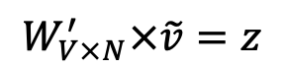
Input layer
0
1
0
cat
0
$$W_{V×N}$$
Hidden layer
Output layer
0
0
0
0
0
0
V-dim
…
0
0
$$W_{V×N}^{′}×\tilde{v}=z$$
0
$$\hat{y}=softmax(z)$$
0
0
0
0
0
$$\hat{v}$$
1
0
$$W_{V×N}$$
…
1
N-dim
0
on
0
${\hat{y}}_{sat}$
0
0
V-dim
0
V-dim
…
N will be the size of word vector
0

Slide 31
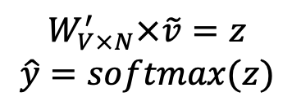
Input layer
0
We would prefer $\hat{y}$ close to ${\hat{y}}_{sat}$
1
0
cat
0
$$W_{V×N}$$
Hidden layer
Output layer
0
0
0
0
0.01
0.02
0.00
0.02
0.01
0.02
0.01
0.7
…
0.00
0
0
V-dim
…
0
0
$$W_{V×N}^{′}×\tilde{v}=z$$
$$\hat{y}=softmax(z)$$
0
0
0
0
0
0
$$\hat{v}$$
1
0
$$W_{V×N}$$
…
1
N-dim
0
on
0
${\hat{y}}_{sat}$
0
0
V-dim
0
V-dim
…
N will be the size of word vector
$\hat{y}$
0

Slide 32
$$W_{V×N}^{T}$$
0.1 | 2.4 | 1.6 | 1.8 | 0.5 | 0.9 | … | … | … | 3.2
0.5 | 2.6 | 1.4 | 2.9 | 1.5 | 3.6 | … | … | … | 6.1
… | … | … | … | … | … | … | … | … | …
… | … | … | … | … | … | … | … | … | …
0.6 | 1.8 | 2.7 | 1.9 | 2.4 | 2.0 | … | … | … | 1.2
Contain word’s vectors
Input layer
0
1
0
x_{cat}
0
Output layer
0
0
$$W_{V×N}^{}$$
0
0
0
0
V-dim
…
0
0
$$W_{V×N}^{′}$$
0
0
sat
0
0
0
0
1
0
$$W_{V×N}^{}$$
…
1
0
V-dim
x_{on}
0
Hidden layer
0
N-dim
0
0
V-dim
…
0
We can consider either W or W’ as the word’s representation. Or even take the average.
Notes:
W contains input word vectors.
W’ contains output word vectors.
We can consider either W or W’ as the word’s representation. Or even take the average.

Slide 33
Skip-gram
Predict context words by the current word
Or more precisely, if there are k context words, we predict one context word based on the current word for k times
E.g., “this is a wonderful day”, window size=1
When current word is “is”, the context words are “this” and “a”
Use “is” to predict “this”
Use “is” to predict “a”
When the current word is “wonderful”, the context words are “a” and “day”
Use “wonderful” to predict “a”
Use “wonderful” to predict “day”

Slide 34
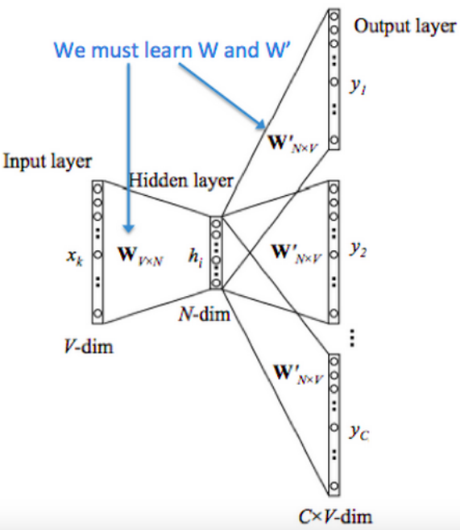

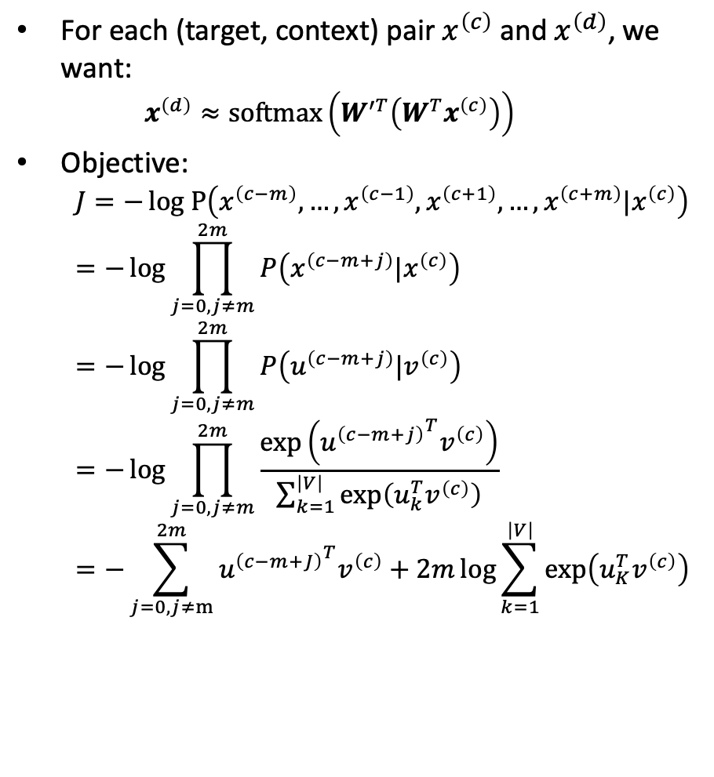
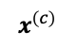

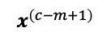
Skip-gram (cont’)
For each (target, context) pair $x^{\left(c\right)}$ and $x^{\left(d\right)}$, we want:
$$x^{\left(d\right)}≈softmax\left(W^{′T}\left({W^{T}x}^{\left(c\right)}\right)\right)$$
Objective:
$$J=−log P\left(x^{\left(c−m\right)},…,x^{\left(c−1\right)},x^{\left(c+1\right)},…,x^{\left(c+m\right)}|x^{\left(c\right)}\right)=−\log{\prod_{j=0,j≠m}^{2m}{P\left(x^{\left(c−m+j\right)}|x^{\left(c\right)}\right)}}=−\log{\prod_{j=0,j≠m}^{2m}{P\left(u^{\left(c−m+j\right)}|v^{\left(c\right)}\right)}}=−\log{\prod_{j=0,j≠m}^{2m}{\frac{\exp\left({u^{\left(c−m+j\right)}}^{T}v^{\left(c\right)}\right)}{\sum_{k=1}^{\left|V\right|}{\exp\left(u_{k}^{T}v^{\left(c\right)}\right)}}}}=−\sum_{j=0,j≠m}^{2m}{{u^{\left(c−m+J\right)}}^{T}v^{\left(c\right)}}+2m\log{\sum_{k=1}^{\left|V\right|}{\exp\left(u_{K}^{T}v^{\left(c\right)}\right)}}$$
$$x^{\left(c−m\right) }$$
$$x^{\left(c\right) }$$
$$x^{\left(c−m+1\right) }$$
$$x^{\left(c+m\right) }$$

Slide 35
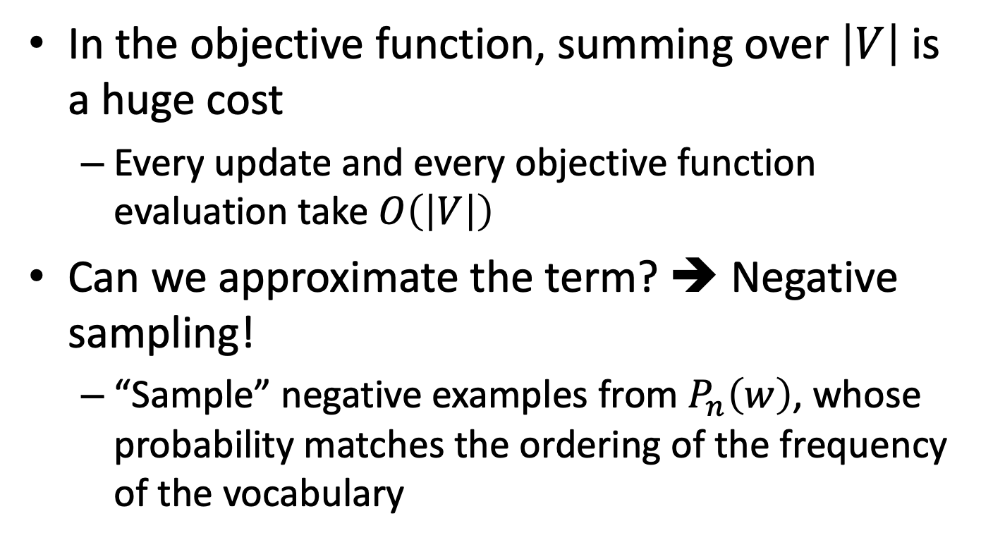
Negative sampling
In the objective function, summing over $\left|V\right|$ is a huge cost
Every update and every objective function evaluation take $O\left(\left|V\right|\right)$
Can we approximate the term? ➔ Negative sampling!
“Sample” negative examples from $P_{n}\left(w\right)$, whose probability matches the ordering of the frequency of the vocabulary

Slide 36
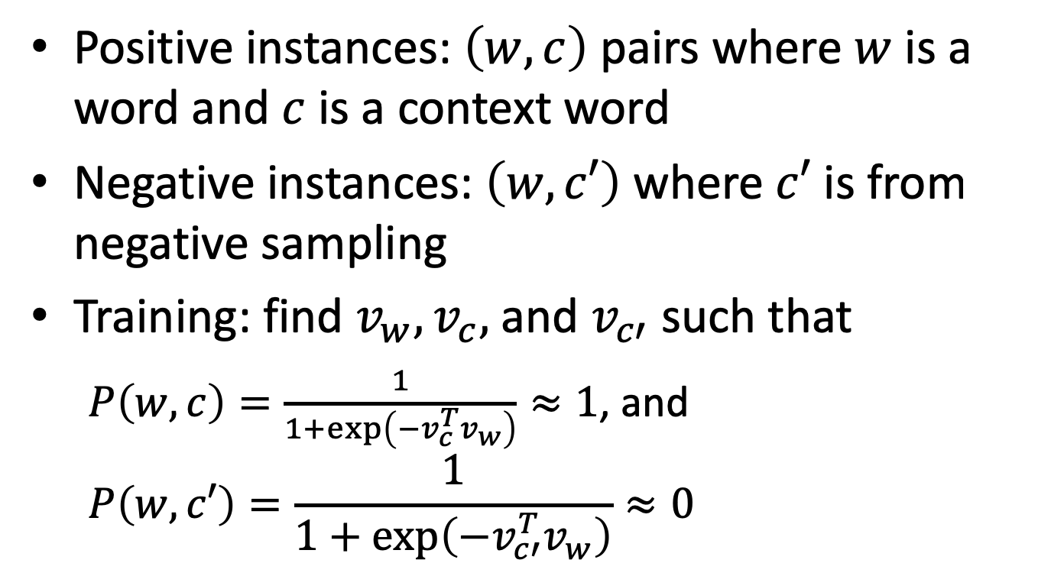
Turning prediction function of skip gram into logistic regression
Positive instances: $\left(w,c\right)$ pairs where $w$ is a word and $c$ is a context word
Negative instances: $\left(w,c′\right)$ where $c′$ is from negative sampling
Training: find $v_{w},v_{c},$ and $v_{c′}$ such that
$P\left(w,c\right)=\frac{1}{1+\exp\left(−v_{c}^{T}v_{w}\right)}≈1$, and
$$P\left(w,c′\right)=\frac{1}{1+\exp\left(−v_{c′}^{T}v_{w}\right)}≈0$$

Slide 37
We may apply similar concept to other domains
As long as you can identify the “relevant object pairs”, it is possible to apply similar concept (X2vec) to your domain

Slide 38
Example: Prod2Vec
Build a recommendation algorithm for a e-commerce website based on clickstream
Generate the embedding for the products and make recommendations based on the distance between product embeddings

Slide 39
Example: Node2Vec
Generate node embeddings for the nodes in a graph

Slide 40
Example: Behavior2Vec
On a e-commerce website, “viewing” a product X and “purchasing” a product X are very different behaviors
Instead of generating embedding for products, we generate two embeddings for each product
Embedding of “buying” a product
Embedding of “viewing” a product
Use different embeddings in different scenarios
Behavior2Vec: Generating Distributed Representations of Users' Behaviors on Products for Recommender Systems Hung-Hsuan Chen TKDD ACM Transactions on Knowledge Discovery from Data 12(4), 2018

Slide 41
Previously, we use “one-hot-encoded” words as input for a NN

Slide 42
But we can use word embedding as the input for a NN
Using Pretrained word embeddings

Slide 43
Summary
Word2Vec generates dense vector (instead of one-hot encoded vector) for each word
Relationship between words may be captured by Word2Vec
Word embeddings are sometimes pre-trained and regarded as the input features to other tasks
We may apply similar concept to many fields

